Slide 1



Hotel System
Network Design

Slide 2



1
Mohamed Mustafa Mohamed
TEAM MEMBERS
2
Marwan Saad
3
Tasneem Mohamed
4
Abdallah Osama
5
Ahmed Mohamed Yehya

Slide 3

Agenda
VLAN Creation and Assignment
Subnetting and IP Addressing
Inter-VLAN Routing
DHCP Server Setup
SSH and Security Configurations
Host Device Configuration and Testing
Telnet, OSPF, EIGRP, and VPN
PAT, ACL, Console, Port Channel, and HSRP

Slide 4

VLAN Creation and Assignment
VLANs provide logical segmentation of departments for enhanced network performance and security.
First Floor
Second Floor
VLAN 60: Logistics (192.168.6.0/24)
VLAN 70: Store (192.168.7.0/24)
VLAN 80: Reception (192.168.8.0/24)
VLAN 30: Sales (192.168.3.0/24)
VLAN 40: HR (192.168.4.0/24)
VLAN 50: Finance (192.168.5.0/24)
Third Floor
Fourth Floor
VLAN 10: IT (192.168.1.0/24)
VLAN 20: Admin (192.168.2.0/24)
VLAN 100: Managers & Owners (192.168.100.0/24)

Slide 5
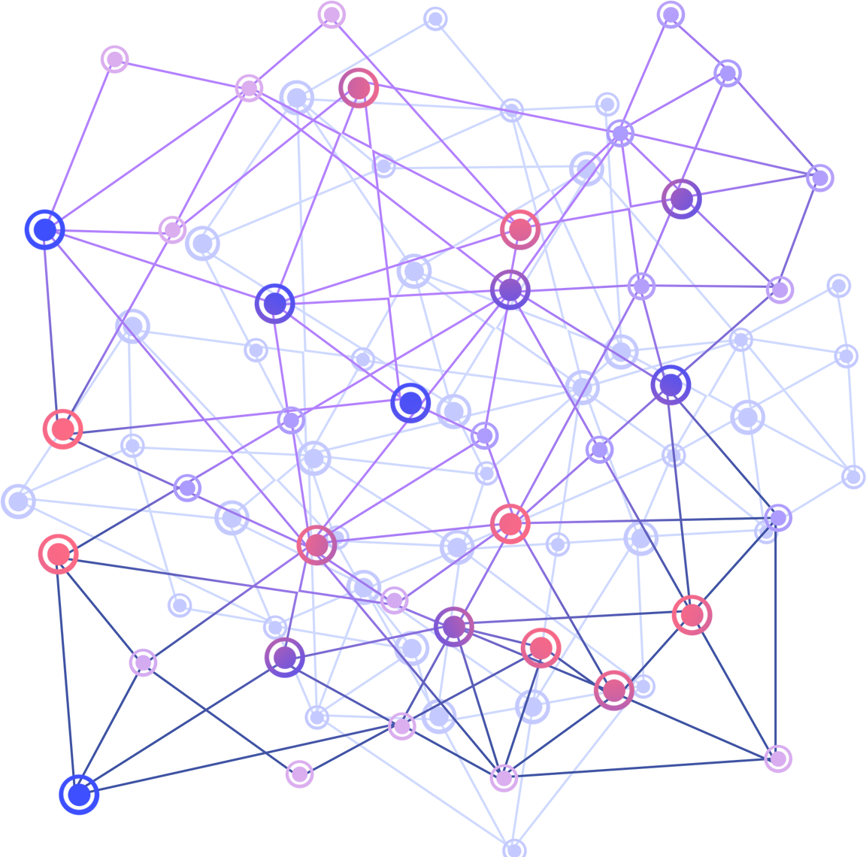
Subnetting and IP Addressing
Subnetting helps in efficient IP address management and isolation of network traffic between departments.
Subnetting Plan:
Each VLAN is assigned a /24 subnet.
Example: VLAN 60 Logistics: 192.168.6.0/24
IP assignment to each device based on their VLAN.

Slide 6
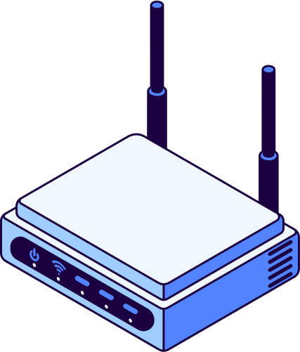
Inter-VLAN Routing (Router on a Stick)
Subnetting helps in efficient IP address management and isolation of network traffic between departments.
Router on a Stick Configuration:
Implemented on routers Core, Child, and Son for inter-VLAN routing.
Sub-interfaces are created on a single physical interface for each VLAN.

Slide 7

DHCP Server Setup
The DHCP server automates IP address assignment, reducing manual configuration efforts.
Router as DHCP Server:
Core Router acts as the DHCP server for the entire network.
IP range assigned to each VLAN for dynamic IP allocation.

Slide 8

SSH and Security Configurations
SSH ensures secure management, and switchport security protects against unauthorized access.
SSH Configuration:
Secure remote access configured on routers Core, Child, and Son.
Password authentication and SSH version 2 enabled.
Switchport Security:
Implemented on 3rd-floor switch, port fa0/2 for PC Test in VLAN 10 (IT).

Slide 9

Host Device Configuration and Testing
Testing ensures successful configuration and that all devices can communicate as intended.
Host Configuration:
IP configuration for all devices based on VLAN assignment.
Host-to-host communication tested across VLANs to verify inter-VLAN routing.

Slide 10

Telnet, OSPF, EIGRP, and VPN
Telnet and VPN provide remote access, while OSPF and EIGRP ensure efficient routing.
Telnet:
OSPF & EIGRP:
Configured on router Serv for remote management.
Configured to enable dynamic routing between routers.
VPN:
VPN setup between Child and Serv routers, with an ISP in between for secure data transmission.

Slide 11

PAT, ACL, and Console Configuration
PAT allows optimized IP address usage, ACL secures network traffic, and console access ensures direct configuration.
PAT (Port Address Translation):
ACL (Access Control Lists):
Configured on Son and Core routers to allow multiple devices to share a single public IP.
Configured for network isolation and control over traffic between VLANs.
Console Configuration:
Console access configured on the fourth-floor router for local management.

Slide 12

Port Channel and HSRP
Port Channel improves performance, while HSRP ensures network resilience and availability.
Port Channel:
Four physical cables between multilayer switches configured as one logical connection, improving bandwidth and redundancy.
HSRP (Hot Standby Router Protocol):
Configured between two multilayer switches for router redundancy.

Slide 13

Thank You!

